Slide 1
Iowa Hog Lift

Slide 2
Many Japanese cities and farms were still recovering from WWII destruction when two typhoons devastated Yamanashi in 1959.

Slide 3
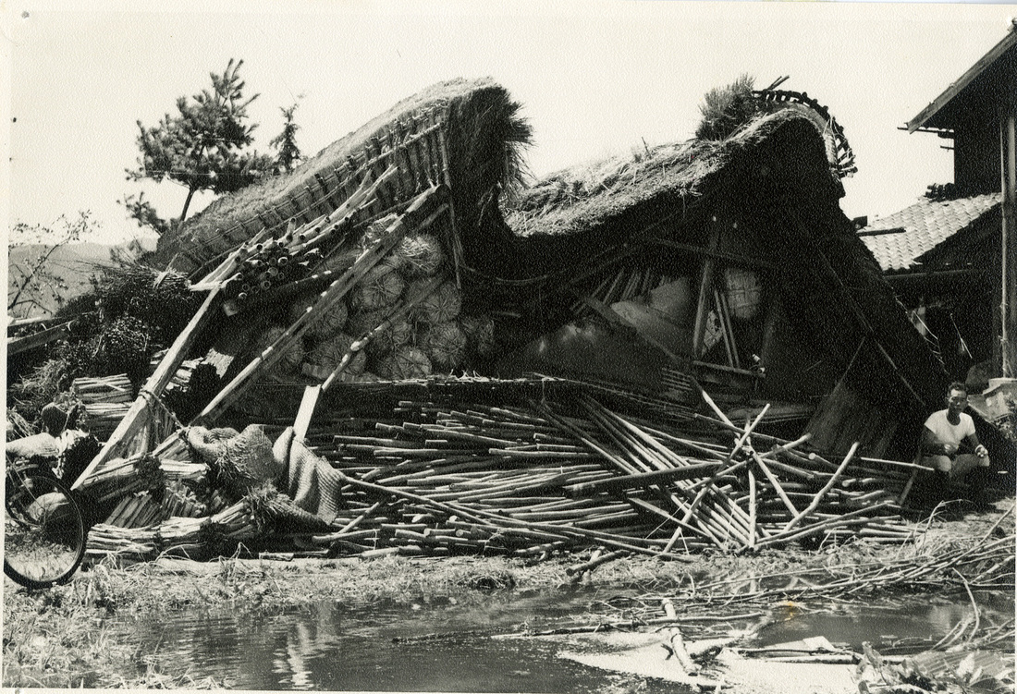
Master Sergeant Richard Thomas (second from left), surveyed typhoon damage in Yamanashi. When he learned of the storms' toll on livestock, Thomas wanted to send hogs from Iowa to replenish herds.

Slide 4
Richard Thomas (second from right) met with Japanese dignitaries in front of the U.S. Air Force C-130, outfitted with aluminum pens for the Hog Lift.

Slide 5
Iowa farmers donated 36 hogs for the project. The Agriculture Department agreed to provide 60,000 bushels of corn for feed from government stocks, but only after department officials were convinced of 'the possibility of selling large amounts' of grain there.

Slide 6
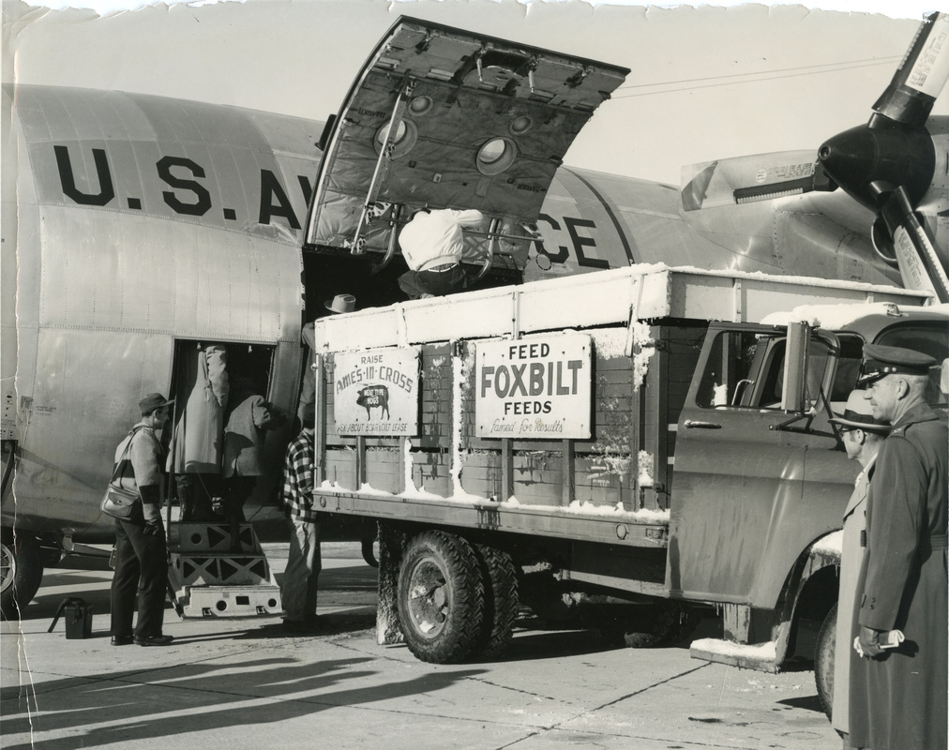
The U.S. Air Force supplied a plane for the hogs; grain was transported to Japan by ship.

Slide 7
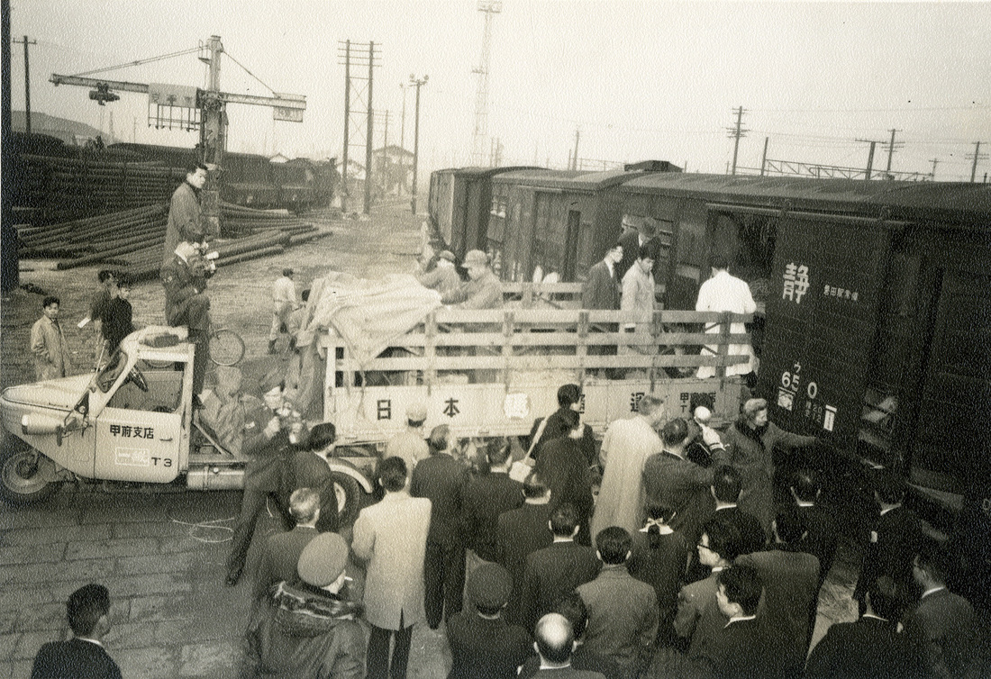
After a two-week quarantine in Tokyo, the 35 surviving hogs (one died en route) were transported to the Shumiyonshi Breeding Station in Kofu, the capital of Yamanashi.

Slide 8
Yamanashi – Iowa 50th Anniversary of Sister State-Prefecture Relations Commemorative Celebration

